Slide 1





Jira-AzureDevops
&
Jira-GitLab
55 Shuman Blvd, Suite 275, Naperville, IL 60563 Tel: +1.630.355.6292 | Email: info@royalcyber.com

Slide 2

Jira-azure devops integration
Power Automate Flows Jira-Azure Devops

Slide 3
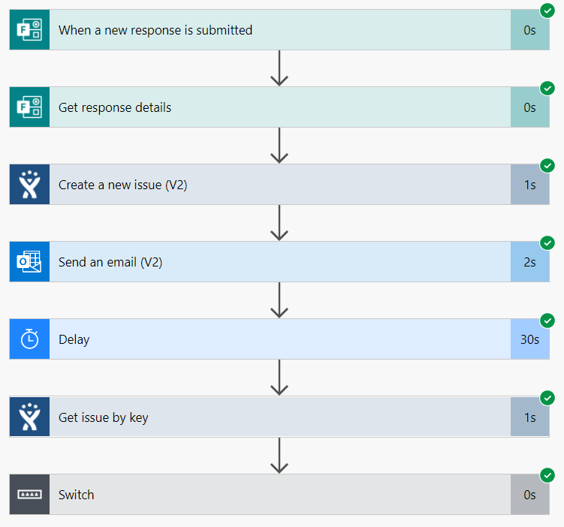
Create an issue in Jira after the approval of Jira Issue, flow creates an epic in Azure Devops

Slide 4
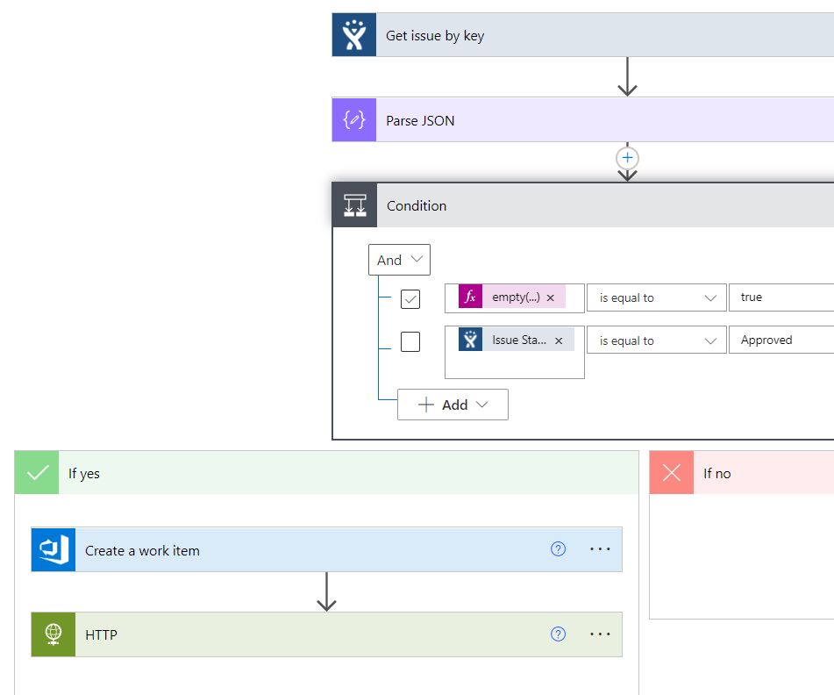
Recurrence Flow Jira-AzureDevops

Slide 5
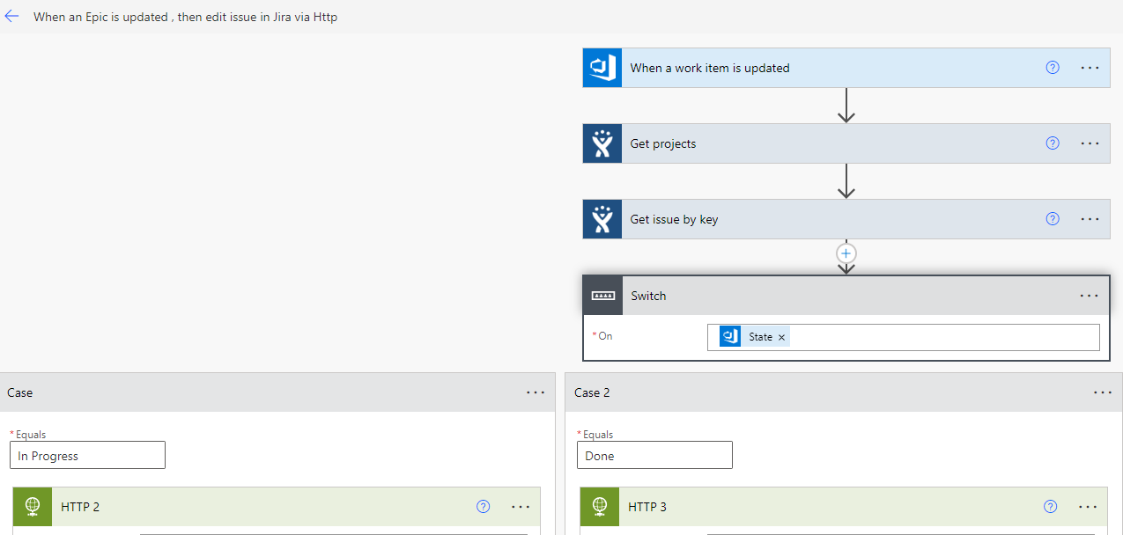
When an Epic is updated, flow edits the issue in Jira

Slide 6
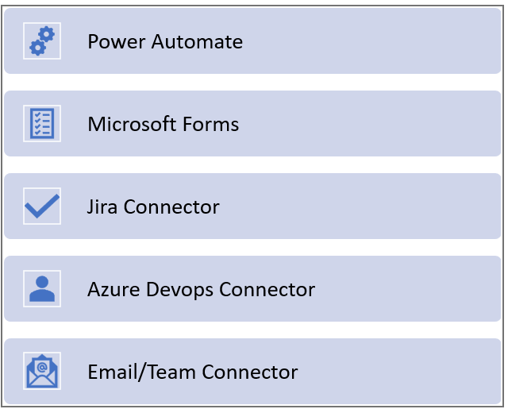
Connectors for Jira-AzureDevops Integration

Slide 7
Jira-GITLAB Integration
Power Automate flows Jira-Gitlab

Slide 8
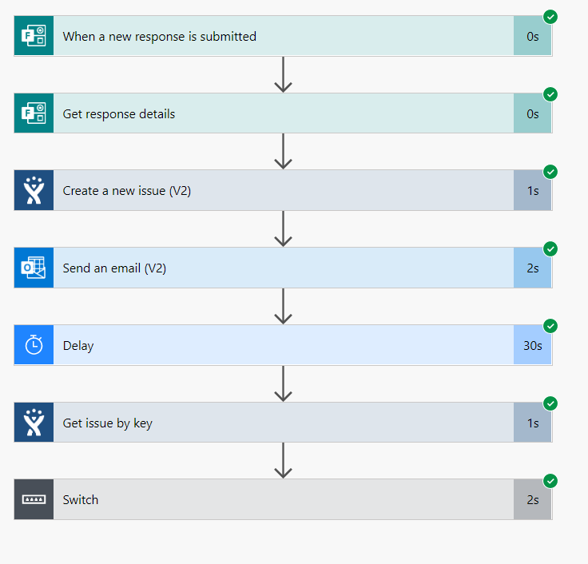
Create an issue in Jira, after the approval of Jira Issue, flow creates an issue in Gitlab

Slide 9
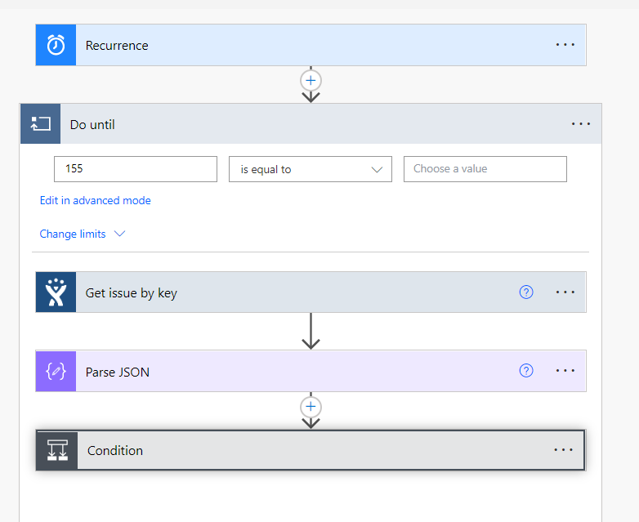
Recurrence Flow Jira-Gitlab

Slide 10
When an issue is updated, flow edits the issue in Jira

Slide 11
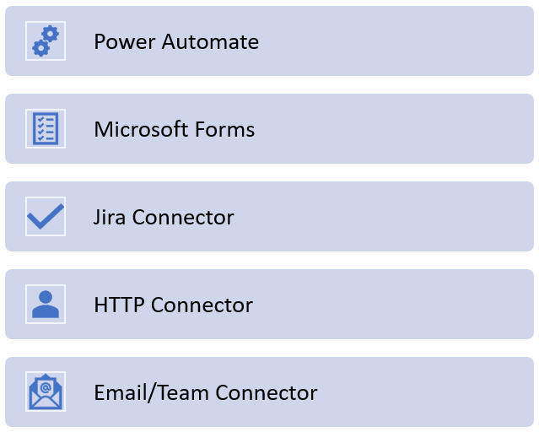
Connectors for Jira-Gitlab Integration

Slide 12
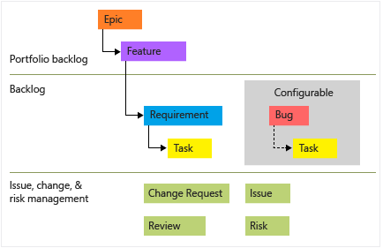
Epics Work-flow
Azure Devops
Gitlab
EPIC
Project1 – issue2
GROUP
Project1-issue1
Project2 – issue1
Tasks
Tasks
Tasks

Slide 13


AzureDevops vs GitLab Features
Features | ADO | GitLab
Supports .Net Applications
In-built connectors for Power Automate
Supports all Stages in a single Yaml file
Creating Custom Fields in Issues
Support and Help Service is High
In Built Security Scanners
Cost for Subscription is Low

